Slide 1

GRAMMAR SUMMARY UNIT 4
Predictions
We use will, may and might to make predictions.
Form
We use the same form of will, may and might for all persons (I, you, he/she/it, etc.) and we don’t need to use a form of do to make questions or negatives. Will, may and might are always followed by the infinitive without to.
Robots will work in our homes.
Note that will is normally contracted after pronouns.
It’ll rain tomorrow. (or It may rain … and It might rain …)
p. 162

Slide 2
The negative of will is won’t. We never contract may not – it always stays as two words.
It won’t rain later. (or It may not rain … and
It mightn’t / might not rain …)
We don’t form questions with may.
Will it rain later? (or Might it rain …)
The most common way to ask somebody to make a prediction is Do you think + will.
Do you think Jackie will like the present?
We don’t normally ask questions about predictions using may.
p. 162

Slide 3
Use
will/won’t
We use will and won’t when we are confident about a prediction. We often add adverbs like certainly, definitely and probably to make a prediction sound stronger. Adverbs like these normally come:
• after will
My job will definitely be very different in the future.
• before won’t
Most people at my company probably won’t have a job next year.
p. 162

Slide 4
may/might
We use may (not) or might (not) when we are less confident about a prediction.
The company may need to close the factory.
They might not give me the job as I don’t have much experience.
There is no difference in meaning between may and might, but may is more common in formal, written English.
We use will/won’t/might/might not + be able to to make predictions about ability.
She probably won’t be able to come to the meeting.
We might be able to get a discount.
 Exercises 1, 2 and 3
p. 156

Slide 5
Future forms
We use different forms to talk about the future.
present continuous
We use the present continuous to talk about a fixed arrangement to do something at a specified (or understood) time in the future. We often use the present continuous when we have agreed to do something with another person, we have bought tickets for something, etc.
I’m meeting my boss at 3.30. (= We both have the meeting in our diary.)
She’s flying to New York next week (= She’s already got her ticket.)
We often use the present continuous to ask people about their plans, especially when we want to make an invitation.
A: Are you doing anything tonight?
B: No, not this evening.
A: Would you like to go and see a film?
p. 162

Slide 6
will
We use will + infinitive without to for a decision made at the moment of speaking.
A: Have you sent Martin the email?
B: No – I’ll do it now.
p. 162

Slide 7
going to
We use going to + infinitive for a plan or intention decided before the moment of speaking.
I’m going to look for a new job. (= This is my intention. I decided this a few days ago.)
Max has got a new job. We’re going to organize a party for him to say goodbye. (= This is our idea, but we don’t have any fixed plans yet.)
The negative of going to is not going to. We don’t normally make the infinitive negative.
He’s not going to come. (not He’s going to not come.)
To make questions with going to, we use are you going to … , is she going to … , etc.
Are you going to send me the report soon?
We can say going to go, but some people prefer to say simply going.
I’m going to go to the dentist later.
(or I’m going to the dentist …)
p. 162

Slide 8
present simple
We use the present simple for an event that follows a regular schedule or timetable, like the time of trains, flights, etc.
My flight leaves at 6.34 am.
My class finishes at 9.30 pm.
We don’t normally use the present simple to talk about an arrangement with other people. We use the present continuous or going to instead.
We’re all meeting in the square at 8 pm.
(not We all meet in the square at 8 pm.)
 Exercises 4, 5 and 6
p. 162

Slide 9
Exercises
1 Correct the mistakes in these sentences.
1 They might to go out for a meal later.
2 James definitely will be late to the meeting.
3 She willn’t spend a lot of money on my birthday present.
4 Some students mayn’t pass their exams.
5 I think you’ll to find a new job soon.
6 My parents won’t probably like the film.
7 I’m sure you’ll able to ski after a few lessons.
8 Robots’ll help us with our household jobs.
might go
James will definitely be
She won’t spend
may not pass
you’ll find
probably won’t like
you’ll be able
Robots will
p. 163

Slide 10
2 Put the words in order to make predictions with will / won’t.
1 snow / it’ll / at the weekend
____________________________________________________.
2 definitely / our meal / won’t / my friend / pay for
____________________________________________________.
3 be / will / open / the shop
____________________________________________________.
4 forget / certainly / their holiday / won’t / they
____________________________________________________.
5 be able to / find / she / our house / won’t
____________________________________________________.
6 be able to / finish / the report / today / we’ll
____________________________________________________.
It’ll snow at the weekend
My friend definitely won’t pay for our meal
The shop will be open
They certainly won’t forget their holiday
She won’t be able to find our house
We’ll be able to finish the report today
p. 163

Slide 11
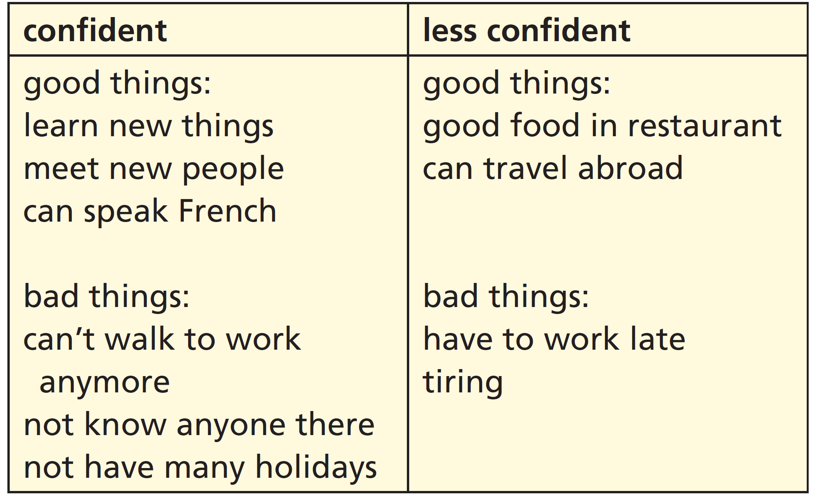
3 Chiara is starting a new job. Look at her predictions about the job and complete the sentences with will/won’t, may/might or may not / mightn’t.
1 My new job ________________
be tiring, but I’m sure I
__________________ learn
a lot of new things.
2 I __________________ know anyone at first, but I ______________ meet new people.
3 I __________________ speak French and I _____________________ travel abroad for work.
4 There __________________ be good food in the restaurant.
5 The office isn’t near my home, so I __________________ walk to work anymore.
6 I __________________ have to work late and I __________________ have many holidays.
may/might
’ll
won’t
’ll
will be able to
may/might be able to
may/might
won’t be able to
may/might
won’t
p. 163

Slide 12
4 Read the sentences (1–6). Choose the correct option (a or b) to explain each sentence.
1 I’m getting a new computer tomorrow.
a I plan to buy a new one.
b I’ve already chosen and ordered one.
2 I’ll have some coffee, please.
a I’d already decided to have this. b I’ve just decided that I want this.
3 He’s going to retake his exam.
a He’s just decided to do this. b He plans to do this.
4 We leave at 6.45 tomorrow morning.
a The train leaves at this time. b We plan to leave at this time.
5 He’s moving abroad for work.
a He plans to do this. b He’s already got his contract.
6 I’ll come to the shop with you after lunch.
a I’ve just decided to do this.
b We’ve already arranged to do this.
p. 163

Slide 13
5 Choose the correct options to complete the email.
Hi Rob
I’m so excited because yesterday I booked a plane ticket for Australia!
1 I’m moving / I’ll move there for a year! 2 I’m working / I’m going to work in Melbourne for the first six months, but I still need to find a job. Then, when I have some money, 3 I’m going to travel / I’m travelling around the country for six months. The only annoying thing is the time of my flight – 4 it’s leaving / it leaves at 4 am! But there are hotels near the airport, so I think 5 I’m booking / I’ll book a room on the internet. I hope everything’s OK with you. 6 Are you doing / Will do you do anything this weekend? Would you like to meet up?
Anders
p. 157

Slide 14
6 Complete the conversations with the correct future form. Sometimes more than one form is possible.
1 A: Sorry, Adrien is busy right now.
B: OK, I ______________ (come) back later.
2 A: Do you want to go out tomorrow evening?
B: Sorry, I ______________ (go) to the theatre. I’ve already bought a ticket.
3 A: What are you doing this evening?
B: I __________________ (study) because I have an exam soon.
4 A: Are you hungry? How about going out for a meal?
B: No, it’s OK – I ______________ (make) something to eat.
5 A: When do you need to be at the station?
B: My train ______________ (leave) at 8.23, so I need to be there at about 8.15.
6 A: Let’s go to the cinema this evening.
B: No, we can’t. We ____________ (meet) Lucy and Mark, remember? I arranged everything yesterday.
’ll come
’m going
’m going to study
’ll make
leaves
’re meeting
p. 157

